Slide 1

No SQL Database
Dept of CSE

Slide 2
Course Objectives
CLO 1. Recognize and Describe the four types of NoSQL Databases, the Document-oriented, Key-Value pairs
CLO 2. Column-oriented and Graph databases useful for diverse applications.
CLO 3. Apply performance tuning on Column-oriented NoSQL databases and Document-oriented NoSQL Databases.
CLO 4. Differentiate the detailed architecture of column oriented NoSQL database, Document database and Graph Database and relate usage of processor, memory, storage and file system commands.
CLO 5. Evaluate several applications for location based service and recommendation services. Devise an application using the components of NoSQL
Dept of CSE
Course Outcomes
CO1. Demonstrate an understanding of the detailed architecture of Column Oriented NoSQL databases, Document databases, Graph databases.
CO2. Use the concepts pertaining to all the types of databases.
CO3. Analyze the structural Models of NoSQL.
CO4. Develop various applications using NoSQL databases.

Slide 3
Assessment Details (both CIE and SEE)
Continuous Internal Evaluation:
Three Unit Tests each of 20 Marks (duration 01 hour) 60M
Two assignments each of 10 Marks 20M
Group discussion/Seminar/quiz any one of three suitably planned 20M
CIE 100 M --> 50 M
SEE 100M ---> 50M
Dept of CSE

Slide 4
Textbooks
1. Sadalage, P. & Fowler, NoSQL Distilled: A Brief Guide to the Emerging World of Polyglot Persistence, Pearson Addision Wesley, 2012
Reference Books
Dan Sullivan, "NoSQL For Mere Mortals", 1st Edition, Pearson Education India, 2015. (ISBN- 13: 978-9332557338)
2. Dan McCreary and Ann Kelly, "Making Sense of NoSQL: A guide for Managers and the Rest of us", 1st Edition, Manning Publication/Dreamtech Press, 2013. (ISBN-13: 978-9351192022)
3. Kristina Chodorow, "Mongodb: The Definitive Guide- Powerful and Scalable Data Storage", 2nd Edition, O'Reilly Publications, 2013. (ISBN-13: 978-9351102694)
Dept of CSE

Slide 5
Weblinks and Video Lectures (e-Resources):
1. https://www.geeksforgeeks.org/introduction-to-nosql/ ( and related links in the page)
2. https://www.youtube.com/watch?v=0buKQHokLK8 (How do NoSQL databases work? Simply
explained)
3. https://www.techtarget.com/searchdatamanagement/definition/NoSQL-Not-Only-SQL (What is
NoSQL and How do NoSQL databases work)
4. https://www.mongodb.com/nosql-explained (What is NoSQL)
5. https://onlinecourses.nptel.ac.in/noc20-cs92/preview (preview of Bigdata course contains
NoSQL)
Dept of CSE

Slide 6
Module - 5
Graph Databases, What Is a Graph Database?, Features, Consistency, Transactions, Availability, Query Features, Scaling, Suitable Use Cases, Connected Data, Routing, Dispatch, and Location-Based Services, Recommendation Engines, When Not to Use.
Dept of CSE

Slide 7
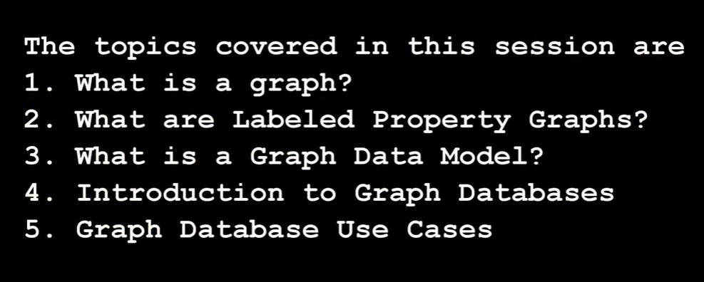
Graph Databases
Dept of CSE

Slide 8
Graph
Graph Databases
It is defined s collection of vertices and edges.
A set of nodes and the relationship that connects them.
Graph represents entities as nodes and the ways in which those entities relate to the world as relationships.
Dept of CSE

Slide 9
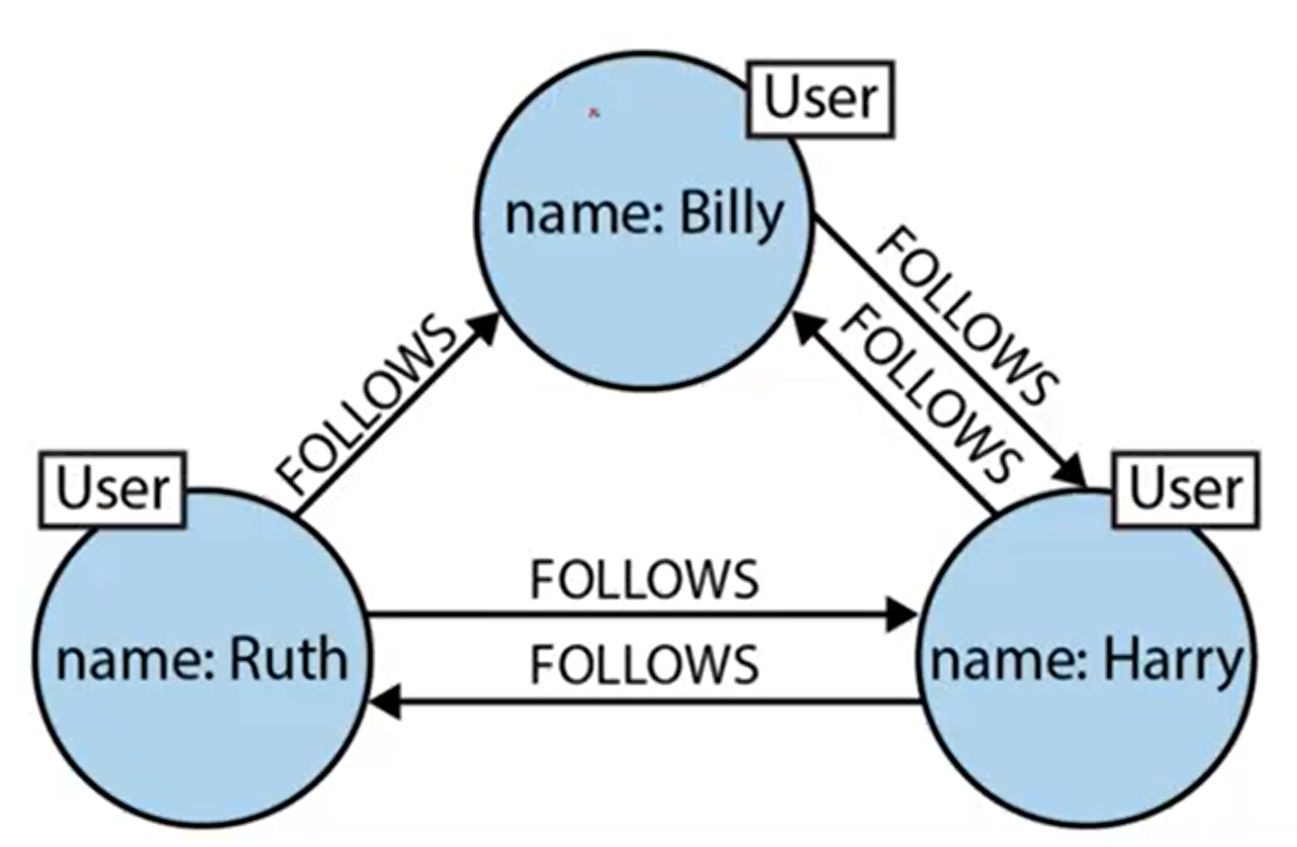
Graph Databases
Dept of CSE
Label (single / Multiples) -> properties
Relationships -> properties

Slide 10
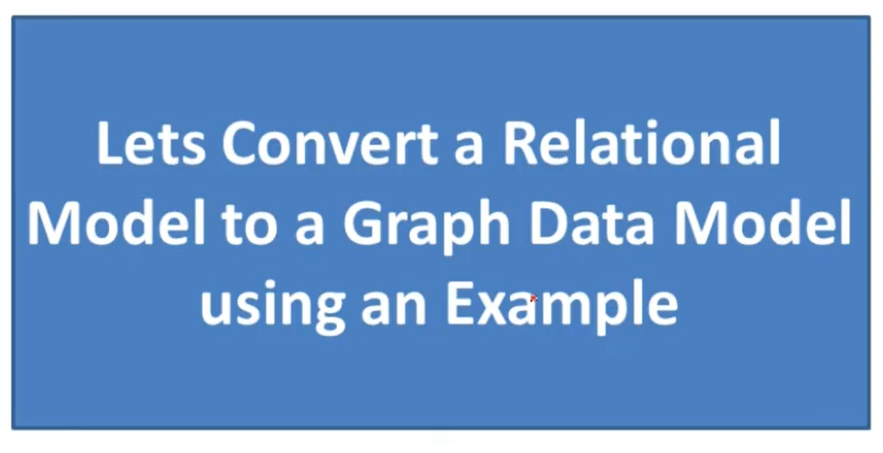
Graph Databases
Dept of CSE

Slide 11
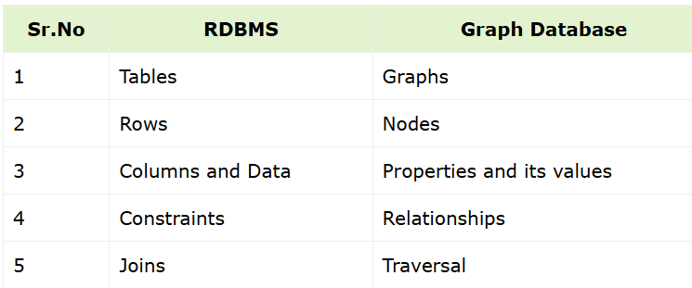
Graph Databases
Dept of CSE

Slide 12
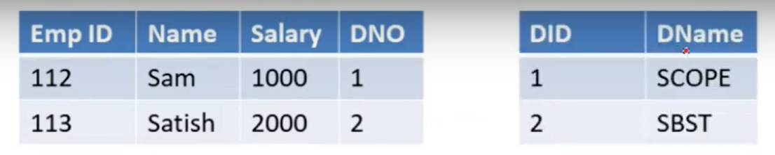
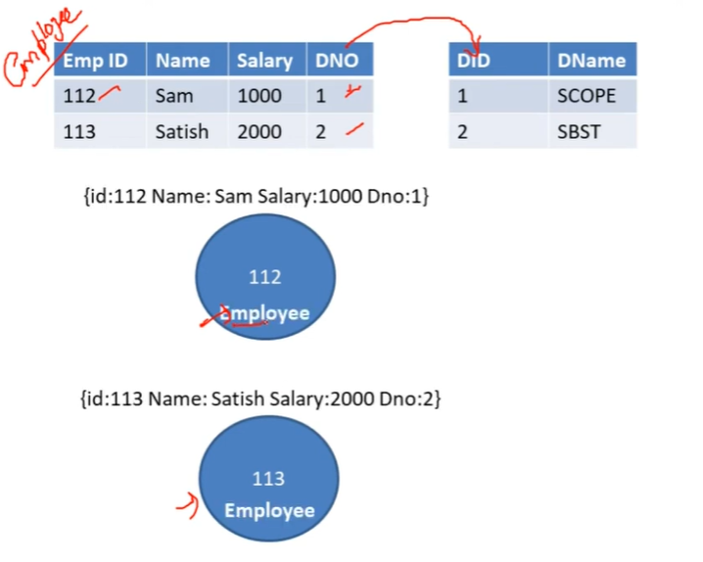
Graph Databases
Dept of CSE

Slide 13
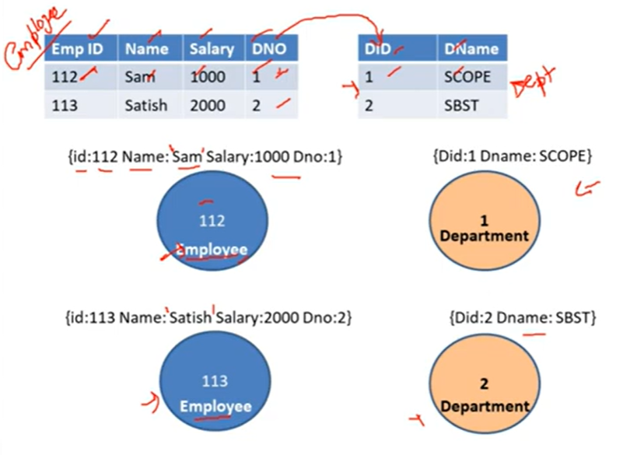
Graph Databases
Dept of CSE

Slide 14
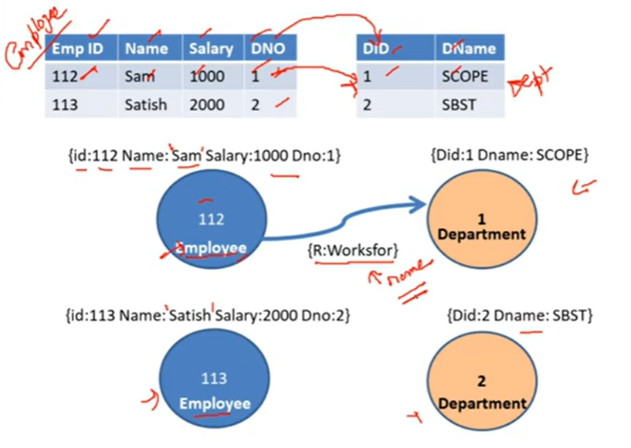
Graph Databases
Dept of CSE

Slide 15
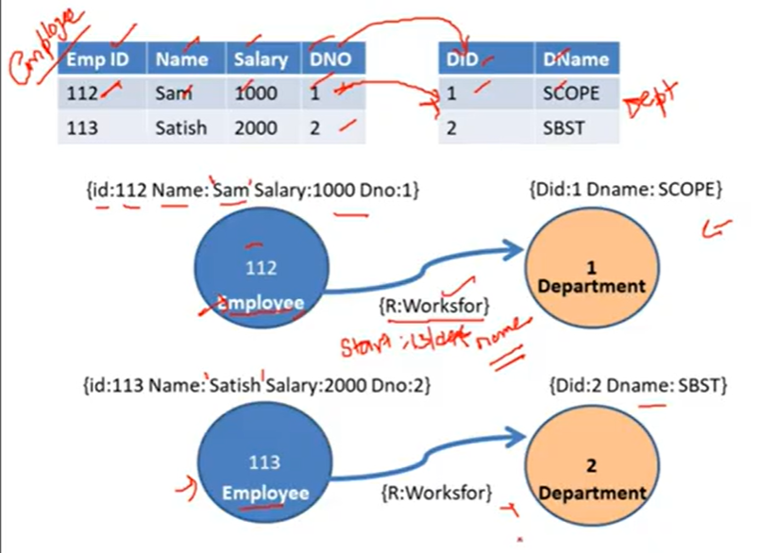
Graph Databases
Dept of CSE

Slide 16
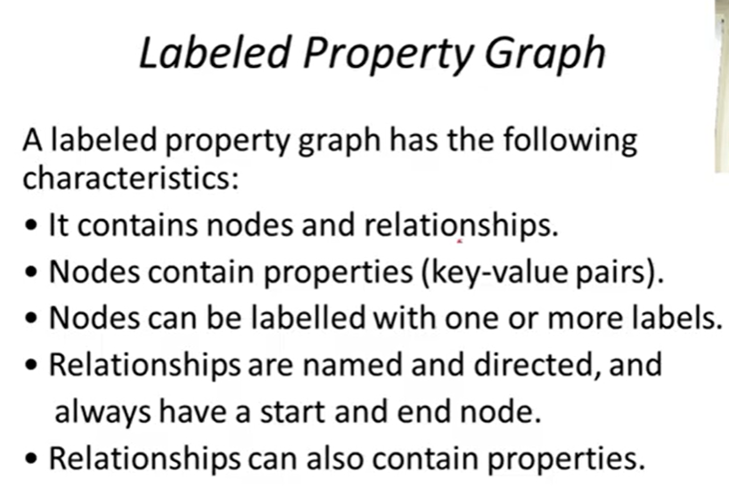
Graph Databases
Dept of CSE

Slide 17
Graph Databases
Graph Database Model
A Graph database management system (henceforth, a graph database) is an online database management system with Create, Read, Update and Delete (CRUD) methods that expose a graph model.
Graph databases are generally built for use with transactional (OLAP) systems.
Dept of CSE

Slide 18
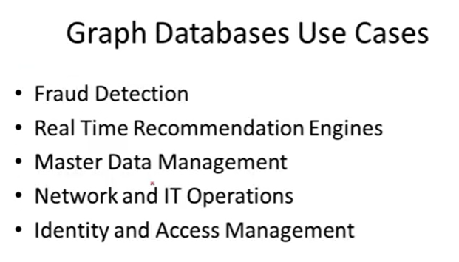
Graph Databases
Dept of CSE

Slide 19
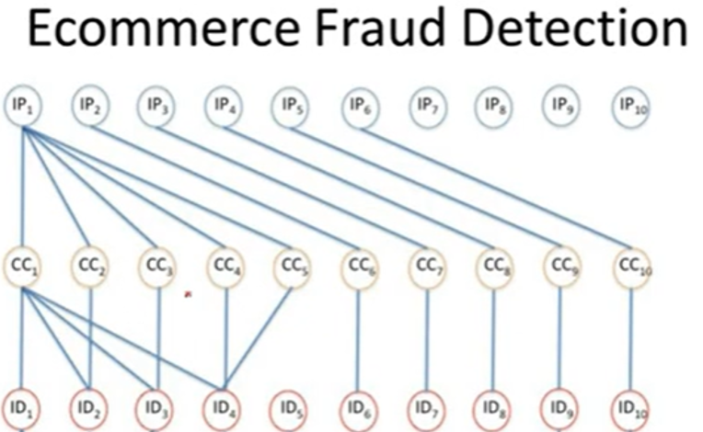
Graph Databases
Dept of CSE

Slide 20
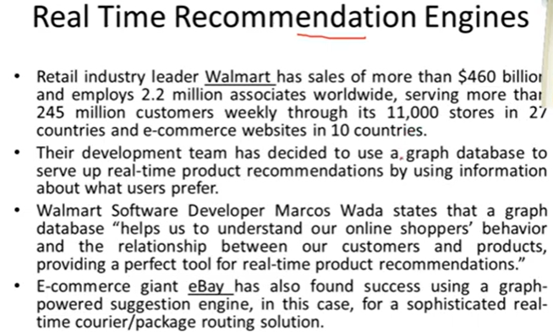
Graph Databases
Dept of CSE

Slide 21
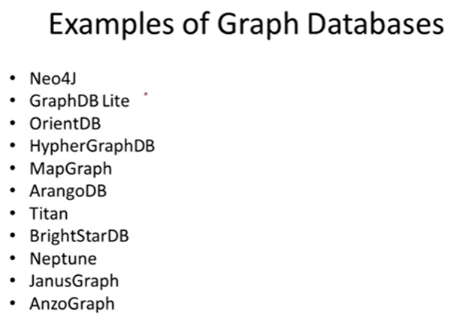
Graph Databases
Dept of CSE

Slide 22
Neo4J
Graph Databases
Neo4j is a graph database that stores data in the form of graphs. The name "Neo4j" comes from the Greek words "neo" (meaning new) and the suffix "4j" (indicating that it's the fourth version of the database).
In Neo4J, creating a graph is as simple as creating two nodes and then creating a relationship.
Let’s create two nodes, Martin and Pramod:
Node martin = graphDb.createNode();
martin.setProperty("name", "Martin");
Node pramod = graphDb.createNode();
pramod.setProperty("name", "Pramod");
Dept of CSE

Slide 23
Graph Databases
We have assigned the name property of the two nodes the values of Martin and Pramod.
Once we have more than one node, we can create a relationship:
martin.createRelationshipTo(pramod, FRIEND); pramod.createRelationshipTo(martin, FRIEND);
Dept of CSE

Slide 24
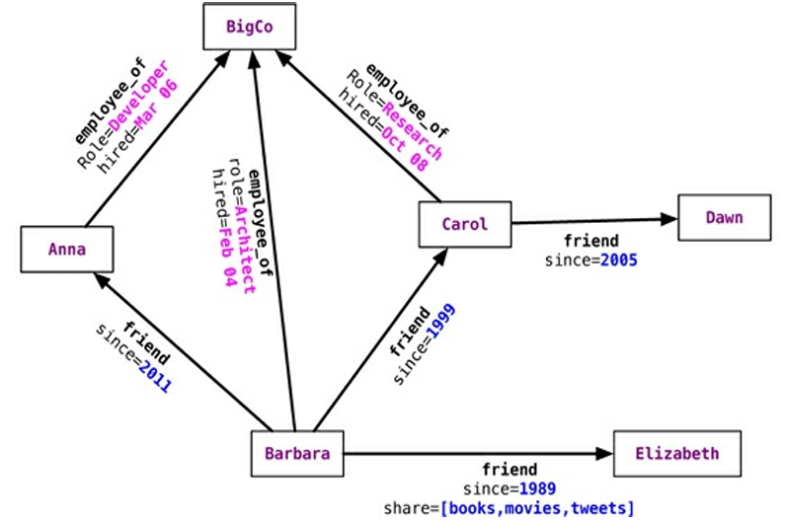
Graph Databases
Dept of CSE

Slide 25
Features of Neo4j
Graph Databases
Following are the notable features of Neo4j −
Data model (flexible schema) − Neo4j follows a data model named native property graph model. Here, the graph contains nodes (entities) and these nodes are connected with each other (depicted by relationships). Nodes and relationships store data in key-value pairs known as properties.
In Neo4j, there is no need to follow a fixed schema. You can add or remove properties as per requirement. It also provides schema constraints.
ACID properties − Neo4j supports full ACID (Atomicity, Consistency, Isolation, and Durability) rules.
Scalability and reliability − You can scale the database by increasing the number of reads/writes, and the volume without effecting the query processing speed and data integrity. Neo4j also provides support for replication for data safety and reliability.
Cypher Query Language − Neo4j provides a powerful declarative query language known as Cypher. It uses ASCII-art for depicting graphs. Cypher is easy to learn and can be used to create and retrieve relations between data without using the complex queries like Joins.
Built-in web application − Neo4j provides a built-in Neo4j Browser web application. Using this, you can create and query your graph data.
Dept of CSE

Slide 26
Advantages of Neo4j
Graph Databases
Following are the advantages of Neo4j.
Flexible data model − Neo4j provides a flexible simple and yet powerful data model, which can be easily changed according to the applications and industries.
Real-time insights − Neo4j provides results based on real-time data.
High availability − Neo4j is highly available for large enterprise real-time applications with transactional guarantees.
Connected and semi structures data − Using Neo4j, you can easily represent connected and semi-structured data.
Easy retrieval − Using Neo4j, you can not only represent but also easily retrieve (traverse/navigate) connected data faster when compared to other databases.
Cypher query language − Neo4j provides a declarative query language to represent the graph visually, using an ascii-art syntax. The commands of this language are in human readable format and very easy to learn.
No joins − Using Neo4j, it does NOT require complex joins to retrieve connected/related data as it is very easy to retrieve its adjacent node or relationship details without joins or indexes.
Dept of CSE

Slide 27
Graph Databases
Dept of CSE

Slide 28
Graph Databases
Dept of CSE

